Slide 1
STM Balt Safe- STM compability onboard.
Welcome to a meeting where all questions are good questions.
If you like to ensure that we have a good answers,
please add them to tendsign well in advance.
Tender-meeting STM Balt Safe-onboard Tue, 1 Oct 2019 10:00 - 12:00 CEST Please join my meeting from your computer, tablet or smartphone. https://global.gotomeeting.com/join/658127989 New to GoToMeeting? Get the app now and be ready when your first meeting starts: https://global.gotomeeting.com/install/658127989
Welcome!
/Cajsa Jesler Fransson

Slide 2
STM is the enabler

Slide 3
What is STM? –The enabler
Enable efficient exchange of information between maritime stakeholders through common standards.
A decentralized service ecosystem for ships, ports and
authorities. Enabling third-parties providing service innovations
Secure and authenticated access to authorized parties.

Slide 5
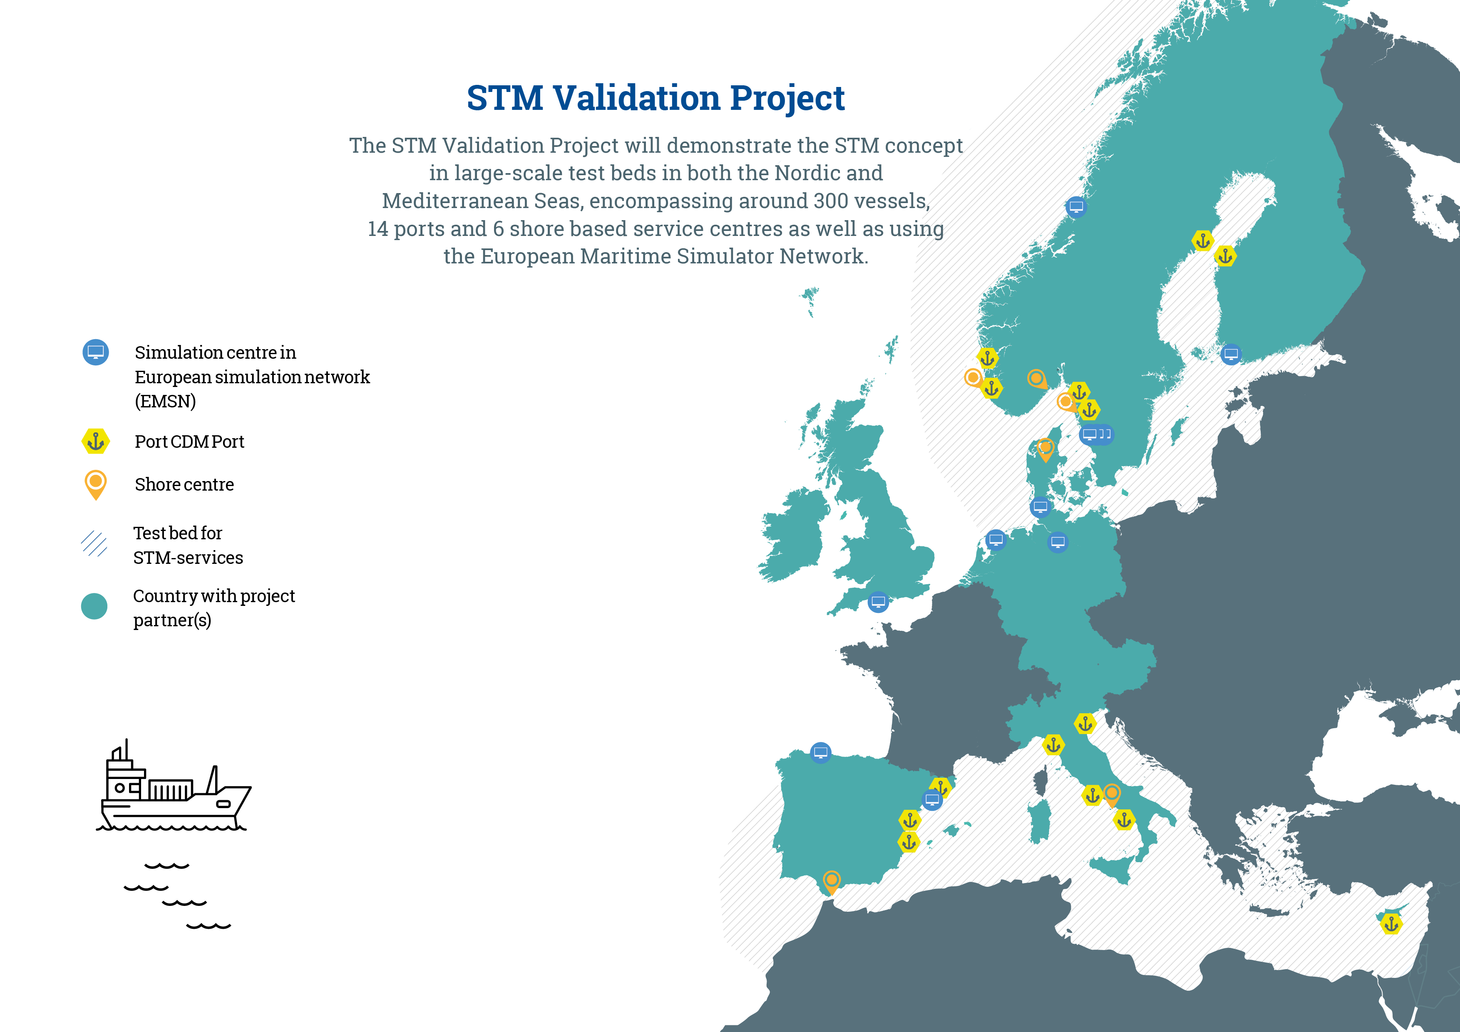

Slide 6
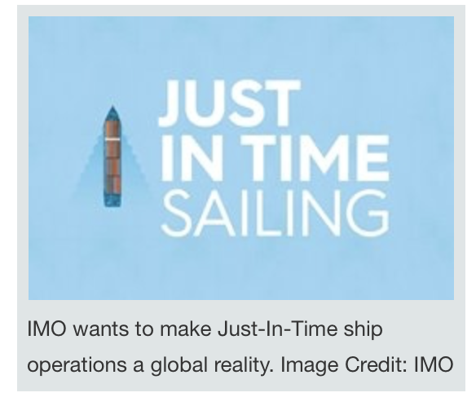
Ships and Ports Need to be Connected!
Notes:
Terminal in Gävle says: We are part of the logistics chain. …

Slide 7
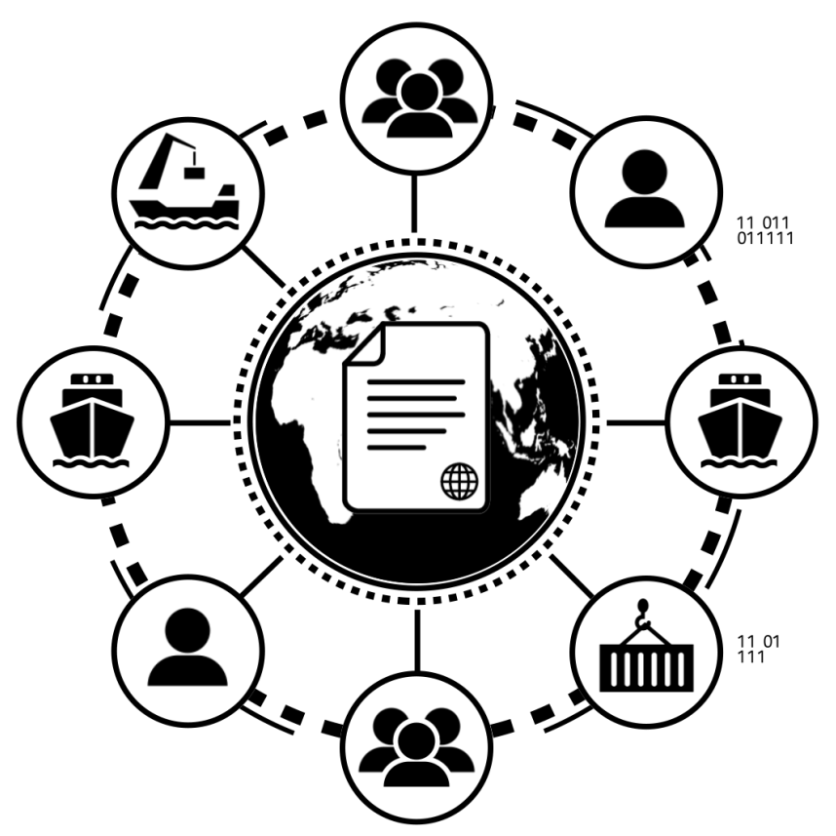
Information sharing
Global standards for ships and port actors
Global reliable infrastructure
Software and services using this global ecosystem
Notes:
- The information sharing within STM is based on international standards and on standardized interfaces. In STM, information is shared in a safe and secure manner, where only authorized parties are allowed to access the information.
-

Slide 8
STM payload formats
AIS ASM
RTZ
S-124
Txt

Slide 9
Services in STM
AIS ASM
Route exchange ship-ship
Sharing of voyage plan
Route cross check
Enhanced monitoring
Ship-port synchronisation
Winter navigation
Area management- Nav warnings
Route optimisation, route segment optimisation
Flow management
Reporting format
RTZ
RTZ
RTZ
Txt
RTZ
Txt
RTZ
Txt
S-124
RTZ
RTZ
Txt
RTZ
AIS ASM
RTZ
Txt
SRS

Slide 10
BaltSafe – objectives
• To improve the safety of navigation of the tanker shipping segment by means of STM
By the exchange of voyage plans, the situational awareness of the involved ships will increase as the ships will be aware of the other ships intentions and can plan their voyages accordingly.
• To provide ships and VTS centres with improved situational awareness
Sea Traffic Management and the ability for the VTS centres to see the ships voyage plans is the biggest operational improvement in the VTS centres since the AIS was implemented in the late 1990´s. The VTS centres will get a much better situational awareness and can support the ships in a completely better way than is the situation today with traffic information, traffic organization and navigational assistance.
• To offer involved ships added value services like for example route optimization, enhanced monitoring and automated reporting by providing an digital infrastructure and environment to operate in
By different maritime services, both public and commercial, the ships will be given easy accessible services like enhanced monitoring by VTS centres, automated reporting that provides a reduction of the administrative burden of the crew and allowing the officers on watch to focus on navigating the ship instead of managing administrative reporting.
• To develop and test new digital VTS services which will improve the speed and accuracy of ship-shore information exchange
Today, much of the interchange between VTS centres and shipping is done by VHF voice. Digital message exchange will bring certainty of information and VTS advice, increasing safety. Automated reporting will reduce the burden on the ships’ crews.

Slide 11
STM Balt Safe
Maintaining the infrastructure

Slide 12
FOCUS ON THE BALTIC SEA –GULF OF FINLAND

Slide 13
Adding tankers-that´t what we do

Slide 14
Testing the STM-clause

Slide 15
Adding Estonian Icebreaker

Slide 16
Upgrading VTS.

Slide 17
Automated SRS and Singel Window reporting

